Slide 1
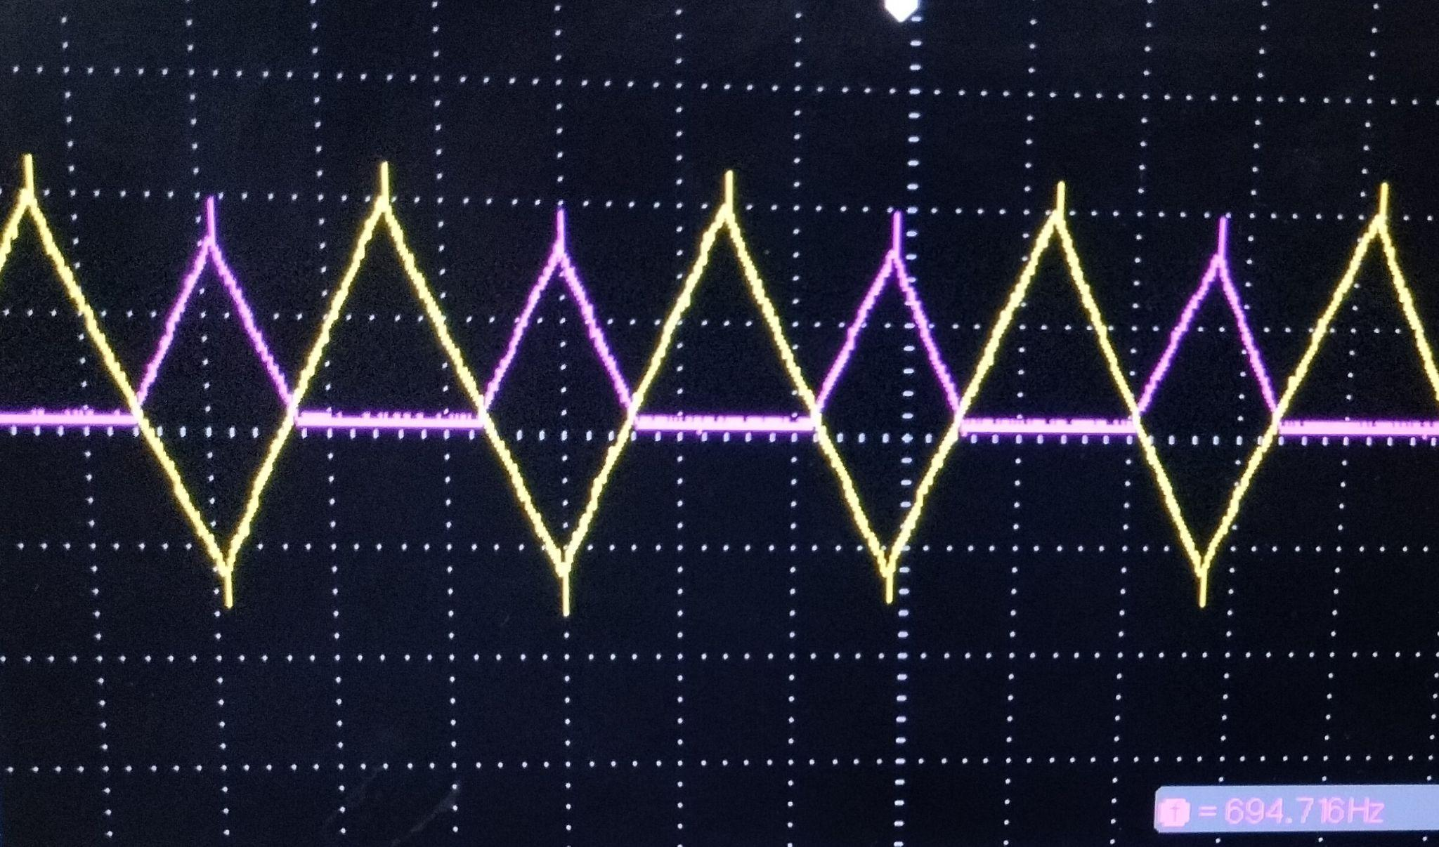
RECTIFIED TRIANGULAR WAVE
EE 204 Analog Circuits Project
Instructor: Dr. Rinkee Chopra
GROUP 10:
Aswini Samantray (12140360)
Sujeet Kumar (12141610)

Slide 2
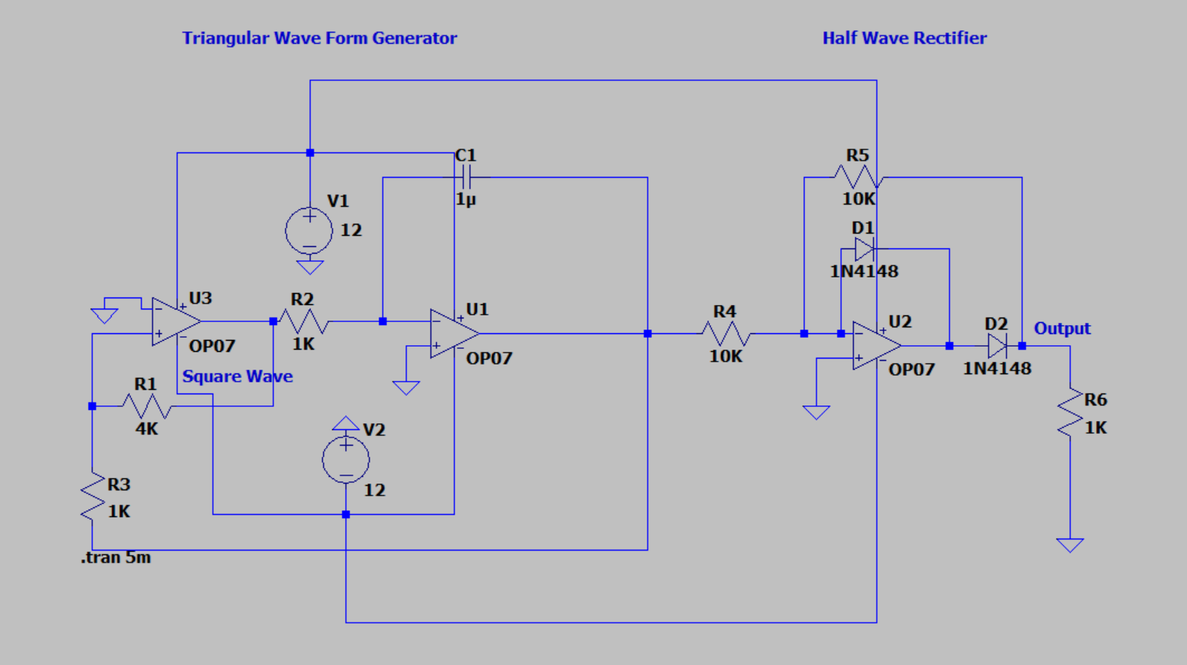
LTSpice Model

Slide 3
Components:
Component | Quantity
LM324 IC | 1
Jumper Wires | -
1uF capacitor | 1
1N4007 diode | 1
10K ohm Resistance | 2
8.2K ohm resistance | 2
1.2K ohm Resistance | 2

Slide 4
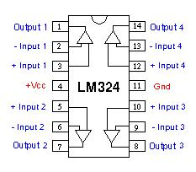
LM324 Pin configuration

Slide 5
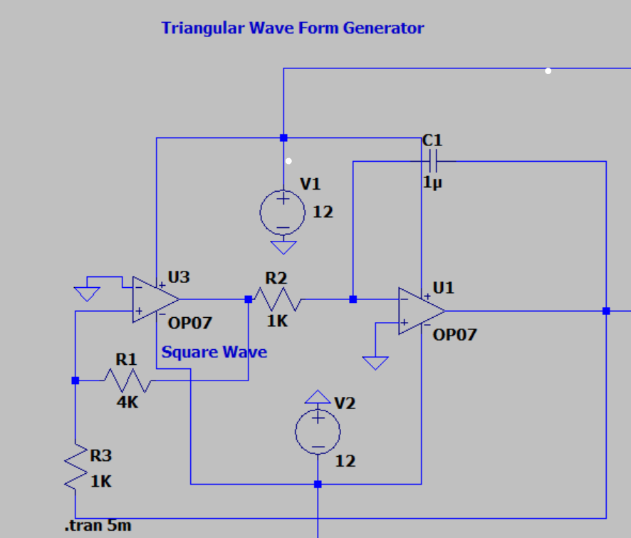
Working of Triangular Waveform generator
At U3,
V₊ = V₀₁(R₃/R₁+R₃) + V₀(R₁/R₁+R₃)
Case 1: V₊ > V₋ :
V₀₁ = V_{SAT}
Case 2 : V₊<V₋ :
V₀₁ = -V_{SAT}
At U1
Due to virtual short, V₋ = 0
I = V₀₁/R_{2,} I_{c} = Cdv_{c}/dt ➡∫dv_{c}=(1/c)(∫I_{c}dt)
V₀ = -V_{c} ➡ V₀= - (1/c)(∫(V₀₁/R₂)dt

Slide 6
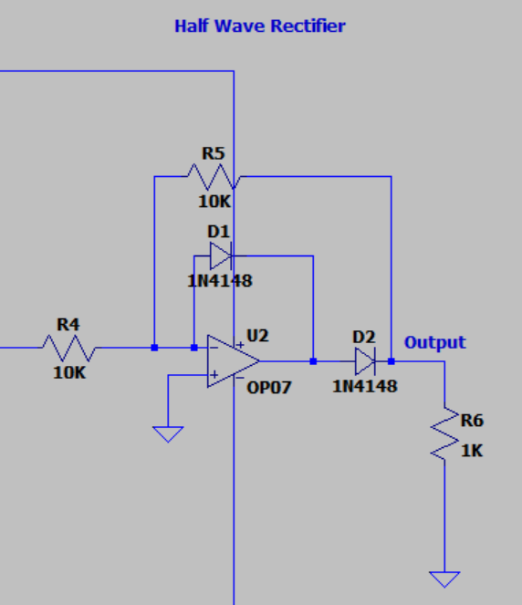
Working of Half Wave Rectifier
For V_{i}>0,
Diode D1 will be ON and diode D2 will be OFF,
Hence, due to virtual short, V₀= 0V,
For V_{i}<0,
Diode D1 will be OFF and D2 will be ON,
Due to virtual short,
V₀ = -V_{i}(R₅/R₄)

Slide 7
Parameters Calculation
The peak to peak output of Triangular wave is : - V_{p-p} = 2(R₃/R₁)(V_{SAT})
Let V_{p-p}= 5V ➡ 5=2(1K/R₁)(10V) ➡ R₁ = 4K
The frequency of V₀ is given by :- f = R₁/(4R₃R₂C)
Here, C = 1uF ➡ R₂ = 1K (at f = 1kH_{z})
For Half Wave Rectifier.
R₄ = R₅= 10K

Slide 8
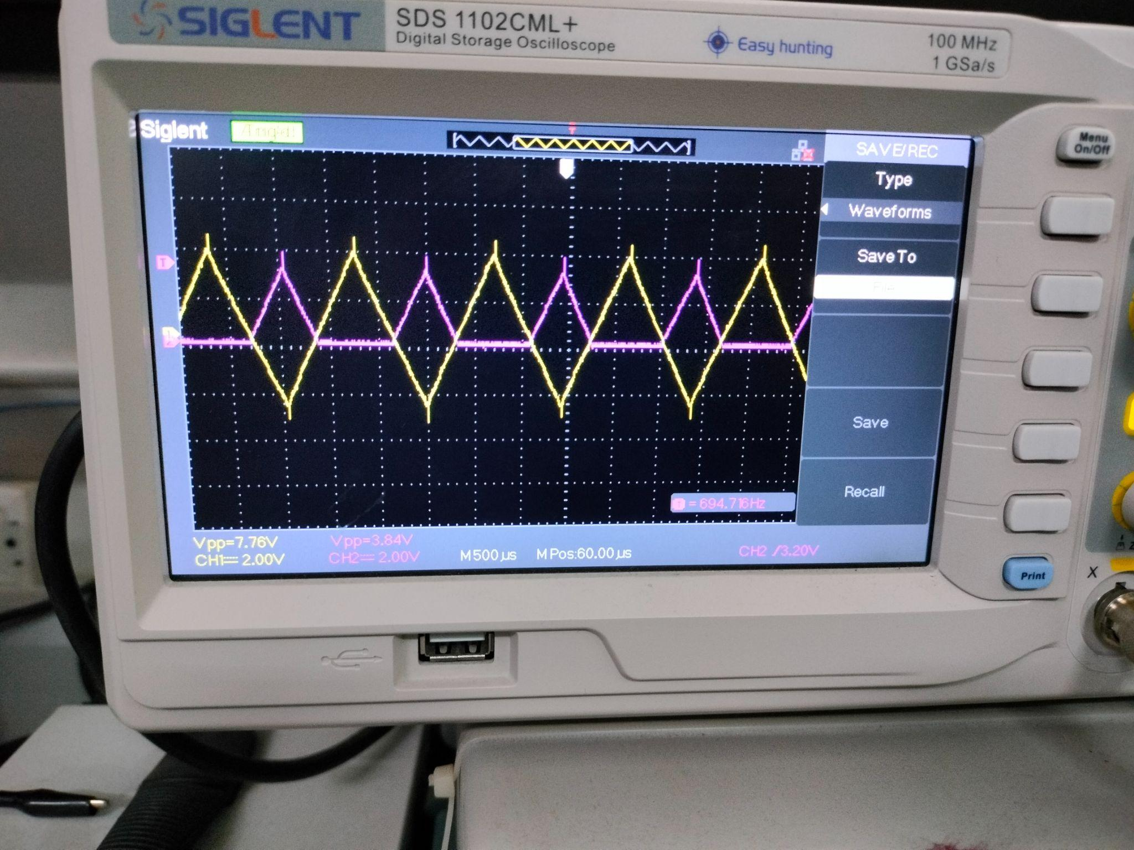
Output Waveforms

Slide 9
THANK YOU

